Slide 1
Sensylink Microelectronics Co., Ltd
Initial draft: 2016/06
Updated: 2019/07
Address: Rm A202-A208, South Hongmei Rd, Minhang District, Shanghai.
website: www.sensylink.com

Slide 2

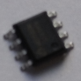

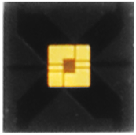
Company Profile
2015.02
在上海成立
2016.03
第一个温度传感器样品
2017.10
第一个温湿度传感器样品
2019.12
第一个气体传感器
引入市场化风险投资
创始团队： 硅谷 + 中国
100% 自主知识产权：已申请专利 60+
国内第一家专注 “环境传感器芯片” 公司

Slide 3























部分客户
通讯:
个人电脑
/服务器:
监控:
家电:
智能硬件:
工业:

Slide 4
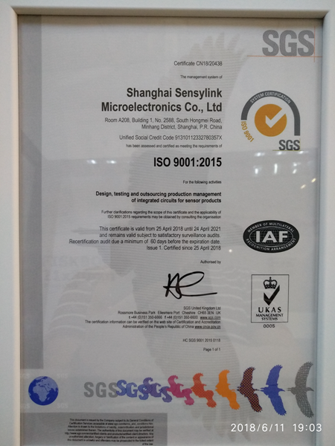
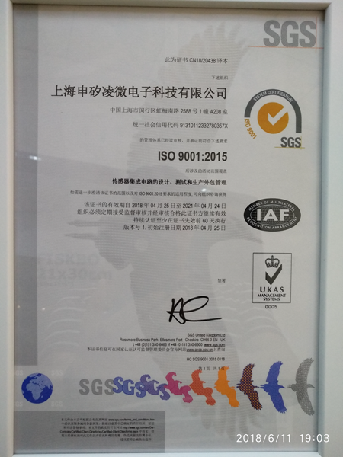
Qualification

Slide 5
Product Roadmap
Y2020
Combo-Sensor
T+H+Gas
T+H+Pressure
T+T+Pressue+Gas
CGHT3xxx
Y2019
Gas-Sensor
CG9508 *
CG9510 *
Y2017
TH-Sensor
CHT8305
CHT1305 *
CHT8430 *
Y2016
*available by 2019/Q4
T-Sensor
CT7310 CT7305/01
CT7315/8 CT1820
CT75 CT1801
CT1712 CT1710/05/01
CT7112 CT7423…*
*available by 2019/Q1
*available by 2018/Q3

Slide 6
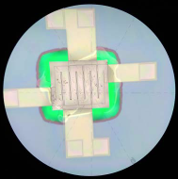
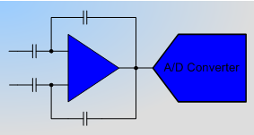
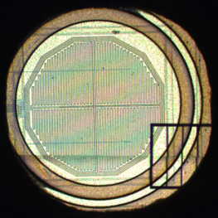
Product Architecture
All sensors are based same architecture, T-Sensor is the basic, H-Sensor and P-Sensor need T compensation, G-Sensor need both T & H compensation.
(Transducer) + (High Precision ADC) + (100% Calibration)
3人
Finger Cap with integrated micro hotplate℗
Customized ADC with Filter ℗
Fast Calibration for MP℗
3人
3人

Slide 7
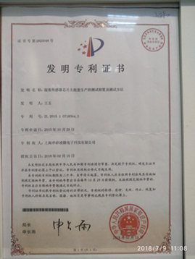
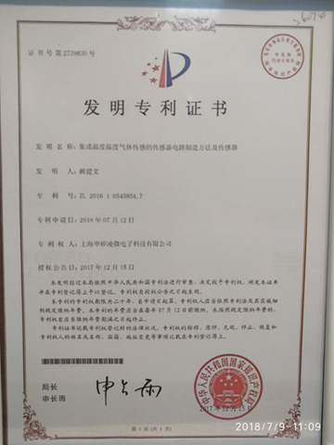
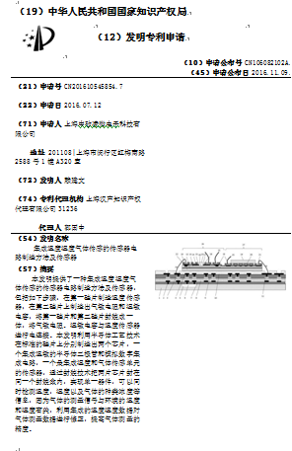
Patents
Patents by 2019.Q1:
Application, 52;
Grant, 21.

Slide 8
T-Sensor Products List
PN | Interface | VCC (V) | Accuracy (ºC) | Channel | Package
CT7302 | SMBus/I²C | 2.5 to 5.5 | ±0.2 | 1 * Local | DFN-3x3-8, SOT-23-5
CT7318 | SMBus/I²C | 3.0 to 5.5 | ±1.0 / ±1.0 | 1 * Local + 1* Remote | SOP-8, MSOP-8, DFN-3x3-8
CT7112 | SMBus/I²C | 1.75 to 5.5 | ±0.5 | 1 * Local | DFN-1.6x1.6-6
CT7423 | SMBus/I²C | 2.7 to 5.5 | ±1.5 / ±1.0 | 1 * Local + 3* Remote | SOP-8
CT75 | SMBus/I²C | 1.75 to 5.5 | ±0.5 | 1 * Local | SOP-8, MSOP-8, DFN-3x3-8
CT7035 | Analog | 1.8 to 5.5 | ±0.5 | 1 * Local | SOT-23, SC70-5
CT7451 | SMBus/I²C | 1.75 to 5.5 | ±1.0 | 1 * Local + 1* Remote | DFN-2x2-8
CT7481 | SMBus/I²C | 1.75 to 5.5 | ±1.0 | 1 * Local + 2* Remote | MSOP-10
CT1801 | Single-Wire | 4.5 to 5.5 | ±0.1 | 1 * Local | TO-92
CT1820 | Single-Wire | 1.8 to 5.5 | ±0.5 | 1 * Local | TO-92, TO-92S, TO-92S-2, SOT-23, MSOP-8
CT1820HT | Single-Wire | 1.8 to 5.5 | ±0.5 | 1 * Local | TO-92
CT1820B | Single-Wire | 1.8 to 5.5 | ±0.5 | 1 * Local | TO-92
CT1820S | Single-Wire | 1.8 to 5.5 | ±0.5 | 1 * Local | TO-92
CT1830 | Single-Wire | 1.8 to 5.5 | ±0.5 | 1 * Local | TO-92
CT1701 | Single-Wire | 3.0 to 5.5 | ±0.1 | 1 * Local | SOT-23
CT1705 | Single-Wire | 2.8 to 5.5 | ±0.5 | 1 * Local | SOT-23
CT1710 | Single-Wire | 2.8 to 5.5 | ±1.0 | 1 * Local | TO-92, SOT-23
CT1712 | Single-Wire | 2.5 to 5.5 | ±1.0 | 1 * Local | TO-92S
CT1712HT | Single-Wire | 2.5 to 5.5 | ±1.0 | 1 * Local | TO-92S
CT1711 | S-Wire | 1.8 to 5.5 | ±0.1 | 1 * Local | SOT-23
CT1720 | S-Wire | 1.8 to 5.5 | ±1.0 | 1 * Local | SOT-23

Slide 9
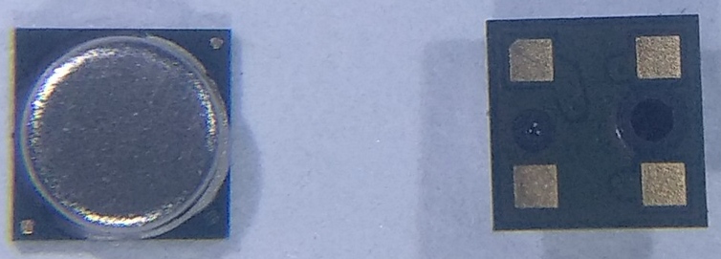
±0.1ºC T-Sensor with S-Wire Interface: CT1711
VCC: 1.8V to 5.5V
Accuracy: ±0.1ºC over 30 to 45ºC
Temperature Range: -50 to 150ºC
Resolution: ±0.00390625ºC (17-bit ADC)
Conversion time: 120ms
Average Current: 4.5uA (1 time/s)
Standby Current: 10nA(Typ.), 30nA(Max.) [<50ºC]
S-Wire Interface (Lite 1-Wire interface)
Compatible with ISO10993.5/10
Improved Heat Conduction Performance for Metal Can Package
Application: Human Body Measurement
Package: MCLGA-3x3-4
Competitors: N/A
PIN1: VCC
PIN2: GND
PIN3: DIO
PIN4: GNDM
3人

Slide 10
±1.0ºC T-Sensor with S-wire interface - CT1720
(Lost Cost)
VCC: 1.8V to 5.5V
Accuracy: ±0.5ºC over -20 to 80ºC
Temperature Range: -50 to 150ºC
Resolution: ±0.03125ºC (14-bit ADC)
Conversion time: 15ms
Average Current: 0.5uA (1 time/s)
Standby Current: 0.1uA(Typ.), 0.3uA(Max.)
S-Wire Interface (Lite 1-Wire interface)
Application: General Temperature Monitor
Package: SOT-23
Competitors: Replace NTC, lost cost product
3人

Slide 11
±0.1ºC T-Sensor with Single-Wire Interface - CT1801
(High-precision)
VCC: 3.0V to 5.5V
Accuracy: ±0.1ºC over -40 to 120ºC
Temperature Range: -50 to 150ºC
Resolution: ±0.0078125ºC (16-bit ADC)
Conversion time, 120ms
Average Current: 4.0uA (1 time/s)
Standby Current: 0.05uA(Typ.), 0.15uA(Max.)
24-bit programmable ID for quick search, match operation or user define
Single-Wire Interface, compatible 1-Wire interface
Application: Industry Chamber Control
Package: TO-92
Competitors: Replace Pt-100/1000
3人

Slide 12
±0.5ºC T-Sensor with 640-bit EEPROM - CT1830
VCC: 1.8V to 5.5V
Accuracy: ±0.5ºC over -10 to 80ºC
Temperature Range: -50 to 150ºC
Resolution: ±0.0625ºC (13-bit ADC)
Conversion time, 30ms
Average Current: 1.0uA (1 time/s)
Standby Current: 0.05uA(Typ.), 0.15uA(Max.)
24-bit programmable ID for quick search, match operation or user define
640-bit EEPROM for user
Single-Wire Interface, compatible 1-Wire interface
Application: Industry Chamber Control
Package: TO-92
Competitors: N/A, CT1820 updated product
3人

Slide 13
±0.5ºC T-Sensor with Single-wire interface - CT1820S
VCC: 1.8V to 5.5V
Accuracy: ±0.5ºC over -10 to 80ºC
Temperature Range: -50 to 150ºC
Resolution: ±0.5ºC (9-bit ADC)
Conversion time, 4ms
Average Current: 0.2uA (1 time/s)
Standby Current: 0.05uA(Typ.), 0.15uA(Max.)
Single-Wire Interface, compatible 1-Wire interface
Application: General Thermal Monitor
Package: TO-92
Competitors: DS18S20
3人

Slide 14
±0.5ºC T-Sensor with Single-wire interface - CT1820B
VCC: 1.8V to 5.5V
Accuracy: ±0.5ºC over -10 to 80ºC
Temperature Range: -50 to 150ºC
Resolution: ±0.0625ºC (13-bit ADC)
Conversion time, 30ms
Average Current: 1.2uA (1 time/s)
Standby Current: 0.05uA(Typ.), 0.15uA(Max.)
Single-Wire Interface, compatible 1-Wire interface
Application: General Thermal Monitor
Package: TO-92
Competitors: DS18B20
3人

Slide 15
T-Sensor with 2-CH (1*Local + 1* Remote) -- CT7318
2019/06 Sample
Key Features
Applications
VCC: 3.0V to 5.5V
Average Current Consumption (Local + Remote):
105uA @ 1.0s/Con
45uA @ 4.0s/Con
Temperature Accuracy:
±1.0ºC(Max.) over 0ºC to 100ºC
±2.0ºC(Max.) over -40ºC to 125ºC
11bit ADC for 0.125ºC resolution
Digital Interface compatible with SMBus, I2C and 2-wire
Programmable Over/Under Temperature
Independed Local, Remote T Sensing
Support SMBus ALERT Response Address(ARA)
Desktop & Notebook Computer
HVAC System
Battery Pack Temperature Monitor
Packages
SOP-8, MSOP-8
DFN-3x3-8
Function Compatible Parts
Ti LM86, TMP431/461
Maxim MAX6657/8
GMT G781/788
3人
3人

Slide 16
T Sensor with 2-CH(1*Local + 1*Remote): CT7451
2019/05Sample
VCC: 1.8V to 5.5V
Accuracy: ±0.5ºC over 0 to 50ºC
Resolution: ±0.0625ºC
Temperature Range: -50 to 150ºC
Compatible 2-Wire/I2C interface
1 * Local + 1 * Remote
Application: PC/Server, DataCom, ONU
Package: SOP-8, MSOP-8, DFN-3x3-8
Competitors:
Ti TMP401, TMP411, TMP421, TMP431, TMP441
TMP451, TMP461
3人

Slide 17
T Sensor with 3-CH(1*Local + 2*Remote): CT7481
2019/06Sample
VCC: 1.8V to 5.5V
Accuracy: ±1.0ºC over 20 to 100ºC
Resolution: ±0.0625ºC
Temperature Range: -40 to 125ºC
Compatible 2-Wire/I2C interface
1 * Local + 2 * Remote
Serial Resistance Cancellation
Application: PC/Server, DataCom
Package: MSOP-10
Competitors:
ADI(ON) ADT7481;
MAXIM MAX6696;
Nuvoton W83773
GMT G780
3人

Slide 18
T Sensor with 4-CH(1*Local + 3*Remote): CT7423
2019/06Sample
VCC: 1.8V to 5.5V
Accuracy: ±0.5ºC over 0 to 50ºC
Resolution: ±0.0625ºC
Temperature Range: -50 to 150ºC
Compatible 2-Wire/I2C interface
1 * Local + 3 * Remote
Application: PC/Server, DataCom
Package: SOP-8/MSOP-8, DFN-3x3-8
Competitors:
Ti TMP423;
Microchip EMC1414
3人

Slide 19
T Sensor with Analog Output: CT7035x
2019/06 Sample
VCC: 2.2V to 5.5V
Accuracy: ±0.5ºC over 0 to 50ºC
Slope [mV/ºC]:
CT7035A, 19.5 CT7035B, 10
CT7035C, 6.25 CT7035D, -5.5
CT7035E, -8.2 CT7035F, -10.9
CT7035G, -11.77 CT7035H, -13.6
Analog Output
Application: Thermal controller, Traditional Output
Package: SOT-23, TO-92, SC-70-3/5
Competitors:
Ti LM35/135/235, TMP35, LMT84/85/87, LM20/50/60/70/90;
Microchip MCP9700;
Maxim MAX6612/3, MAX6607/8
3人

Slide 20
T-Sensor -- CT7302
Key Features
Applications
VCC: 2.5V to 5.5V
Average Current Consumption: 15uA(Typ.) @ 1.0Con/s
Standby Current: 0.1uA(Typ.), 0.3uA(Max.)
Temperature Accuracy:
±0.2oC(Max.) from -20oC to 80oC
±0.5oC(Max.) from -20oC to 100oC
±1.0oC(Max.) from -55oC to 125oC
Compatible with SMBus, I2C and 2-wire
Programmable active High/Low for ALERT Output
Generate 4 different slave address
Human Body Measurement
Thermal Monitor/Management
Function Compatible Parts
Ti, TMP112
Si705x
Packages
SOT-23-5
DFN-3x3-8
3人
3人

Slide 21
T-Sensor -- CT75
Key Features
Applications
VCC: 1.75V to 5.5V
Average Current Consumption: 10uA (Max.)
Temperature Accuracy: ±0.5ºC over 0ºC to 50ºC
Digital resolution 0.0625ºC (12bit ADC)
Compatible with SMBus, I2C and 2-wire
Programmable Over/Under Temperature
Programmable active High/Low for ALERT Output
Support SMBus ALERT Response Address(ARA)
Generate 32 different slave address by A0/A1/A2 PIN
Smart HVAC System
Thermal Monitor/Management
PC or Server
Function Compatible Parts
Ti, LM75/A/B/C, TMP75/175/275
Maxim, DS75
ST, STxx75
Microchip, TCN75
On semi, NCT75, ADT75
Packages
SOP-8, MSOP-8
3人
3人

Slide 22
T-Sensor -- CT7112
Key Features
Applications
VCC: 1.5V to 5.5V
Average Current Consumption: 10uA (Max.)
Temperature Accuracy: ±0.5ºC over 0ºC to 50ºC
Digital resolution 0.0625ºC (12bit ADC)
Compatible with SMBus, I2C and 2-wire
Programmable Over/Under Temperature
Programmable active High/Low for ALERT Output
Support SMBus ALERT Response Address(ARA)
Generate 4 different slave address by A0 PIN
Smart HVAC System
Thermal Monitor/Management
PC or Server
Function Compatible Parts
Ti, TMP112/102
Packages
DFN-1.6x1.6-6
CT7112A
CT7112B
3人
3人

Slide 23
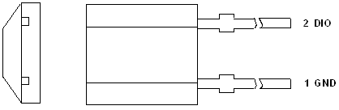
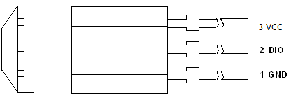
T-Sensor -- CT1820
Key Features
Applications
VCC: 2.5V to 5.5V
Current Consumption:
30uA during Temperature Conversion
Temperature Accuracy:
±0.5ºC(Max.) over -10ºC to 85ºC
±1.0ºC(Max.) over -10ºC to 100ºC
±2.0ºC(Max.) over -55ºC to 125ºC
Conversion time: 30ms(Typ.) @ 12-bit
Digital resolution 0.0625ºC (12bit ADC)
Compatible with Single-Line, 1-wire
Programmable Over/Under Temperature
Temperature up to 160ºC Max. (CT1820HT)
Digital Thermometer
Smart HVAC System
Long distance, numerous temperature sampling Application
Function Compatible Parts
DS18B20
Packages
TO-92, TO-92S, TO-92S-2
SOT-23, MSOP-8
3人
3人

Slide 24
T-Sensor -- CT1712
Key Features
Applications
VCC: 2.5V to 5.5V
Current Consumption:
15uA during Temperature Conversion
Temperature Accuracy:
±1.0ºC(Typ.) over 0ºC to 85ºC
Conversion time: 35ms(Typ.) @ 12-bit
Digital resolution 0.0625ºC (12bit ADC)
Single-Line Digital interface
Temperature up to 160ºC Max. (CT1712HT)
General Temperature Monitor
White Appliance
Smoke/Heater Detector
Packages
TO-92S-2 (2PIN)
3人
3人

Slide 25
T-Sensor -- CT1710
Key Features
Applications
VCC: 2.8V to 5.5V
Current Consumption:
15uA during Temperature Conversion
Temperature Accuracy:
±1.0ºC(Typ.) over 0ºC to 85ºC
Conversion time: 35ms(Typ.) @ 12-bit
Digital resolution 0.0625ºC (12bit ADC)
Single-Line Digital interface
General Temperature Monitor
White Appliance
Packages
SOT23-3/TO-92
3人
3人
Low Cost Digital Thermal Sensor

Slide 26
T-Sensor -- CT1705
Key Features
Applications
VCC: 2.8V to 5.5V
Current Consumption:
15uA during Temperature Conversion
Temperature Accuracy:
±0.5ºC(Typ.) over -30ºC to 50ºC
Conversion time: 35ms(Typ.) @ 12-bit
Digital resolution 0.0625ºC (12bit ADC)
Single-Line Digital interface
General Temperature Monitor
White Appliance
Temperature Logger
Packages
SOT23-3
3人
3人

Slide 27
T-Sensor -- CT1701
Key Features
Applications
VCC: 2.8V to 5.5V
Current Consumption:
15uA during Temperature Conversion
Temperature Accuracy:
±0.1ºC(Typ.) over 33ºC to 43ºC
Conversion time: 35ms(Typ.) @ 12-bit
Digital resolution 0.0625ºC (12bit ADC)
Single-Line Digital interface
General Temperature Monitor
Human Body Temperature Monitor
Packages
SOT23-3
3人
3人

Slide 28
CT75 vs. LM75/TMP75…
PN |  | CT75 | TMP75 | TCN75A | LM75A | NCT75
VCC Range (V) |  | 1.75-5.5 | 2.7-5.5 | 2.7-5.5 | 2.8-5.5 | 3.0-5.5
Temperature Range (ºC) |  | -55 to 125 | -40 to 125 | -40 to 125 | -55 to 125 | -55 to 125
Accuracy(ºC) [Typ/Max] |  | ±0.5/±1.5 | ±0.5/±2.0 | ±1.0/±2.0 | ±1.0/±2.0 | ±1.0/±2.0
Power Consumption (Typ./Max.) [uA] |  | 7/10 | 50/85 | 200/500 | 100/NA | 440/580
Shutdown Current (Typ) |  | 1.5uA | 0.1uA | 2.0uA | 3.5uA | 3.0uA
Conversion time(us) |  | 30ms | 220ms | 30ms | 100ms | 48.5ms
Standard Alone Thermostat |  | YES | N/A | N/A | N/A | N/A
SMBus ARA |  | YES | No | No | No | No
I2C Max. Freq (kHz) |  | 3,400 | 3,400 | 400 | 400 | 400
Slave Address |  | 32 | 8 | 8 | 8 | 8
ESD | HBM | 6000 | 4000 | 4000 | 2000 | 2000
 | MM | 600 | 300 | 400 | 200 | 400
 | CDM | 1000 | 1000 |  | 1000

Slide 29
CT1820 vs. DS18B20
Parameters | CT1820 | DS18B20
Supply Voltage [V] | 1.8V to 5.5V | 3.0V to 5.5V
Temperature Conversion Current [uA] | 30[Typ.]/60[Max.] | 1000[Typ.]/1500[Max.]
Conversion Time @12bit [ms] | 30.0 | 750
Conversion Time Temp-Coe [ppm/ºC] | 19.5 | 129.9
Standby Current [nA] | 50[Typ.]/200[Max.] | 700[Typ.]/1000[Max.]
Temperature Accuracy [ºC] | ±0.5, or ±0.2 or ±0.1 | ±0.5
Communication Rate | Selectable […0.5x, 1.0x, 2.0x…] | 16kbps fixed

Slide 30
TH-Sensor Products List
PN | Interface | VCC (V) | Temperature Accuracy (ºC) | Humidity Accuracy (RH%) | Package
CHT8305/C | SMBus/I²C | 2.5 to 5.5 | ±0.5 | ±3.0 | DFN-3x3-6
CHT1305 | 1-Wire/Single-Wire | 1.8 to 5.5 | ±0.5 | ±3.0 | DFN-3x3-6

Slide 31
TH-Sensor -- CHT8305/C
Key Features
Applications
VCC: 2.5V to 5.5V
Average Current: 1.5uA(Typ.), 3.0uA(Max.)
Shutdown Current: 0.15uA(Typ.), 0.3uA(Max.)
Temperature Accuracy: ±0.5ºC over 0ºC to 50ºC
Humidity Accuracy: ±3.0%RH over 20 to 80%RH
14-bit ADC for Temperature and Humidity
Compatible with I²C and 2-wire
Programmable high-limit of Temperature/humidity
Generate 4 different slave address by AD0 pin
Protection Cover is available option
Smart HVAC System
Environment Monitor
Portable/Wearable Weather Monitor
Smart Air Cleaner
Function Compatible Parts
Sensirion, SHT3x, SHT2x
Packages
DFN-3x3-6
3人
3人

Slide 32
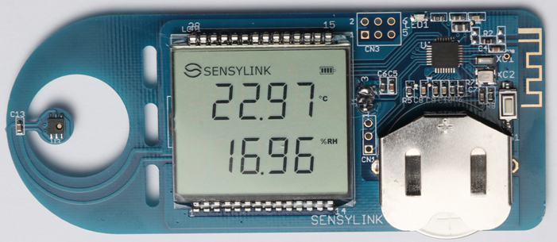
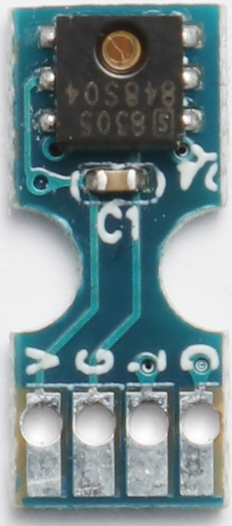
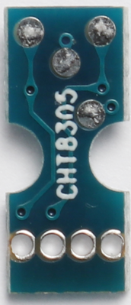
CHT8305 Demo Kit & CHT8305 Module

Slide 33
TH-Sensor with Single-Wire Interface -- CHT1305
2019/02 Sample
Key Features
Applications
VCC: 2.2V to 5.5V
Average Current: 1.8uA(Typ.), 4.5uA(Max.)
Shutdown Current: 0.1uA(Typ.), 1.0uA(Max.)
Temperature Accuracy: ±0.5ºC over 0ºC to 50ºC
Humidity Accuracy: ±3.0%RH over 20 to 80%RH
640-bit Memory available for user
Single-Wire Interface, support parasitic power supply mode
Permit to connect with CT1820 together at same bus.
Protection Cover is available option
Competitor: N/A
Smart HVAC System
Grain Moisture Monitor
Environment Monitor
White Appliance
Packages
DFN-3x3-6
3人

Slide 34
CHT8305 vs. SHT2x, SHT3x
Parameters | CHT830x | SHT2x | SHT3x
Standby Current (Typ./Max.)[nA] | 100/200 | 150/400 | 200/3000
Temp Variation @ 25ºC | 0.03 | 0.06 | 0.04
Humidity Variation @ 50%RH | 0.04 | 0.08 | 0.04
Slave Address (setting by AD0) | 4 | 1 | 2
ALERT Feature | Yes | No | Yes
Particle Sensitivity | Low | High | Middle

Slide 35
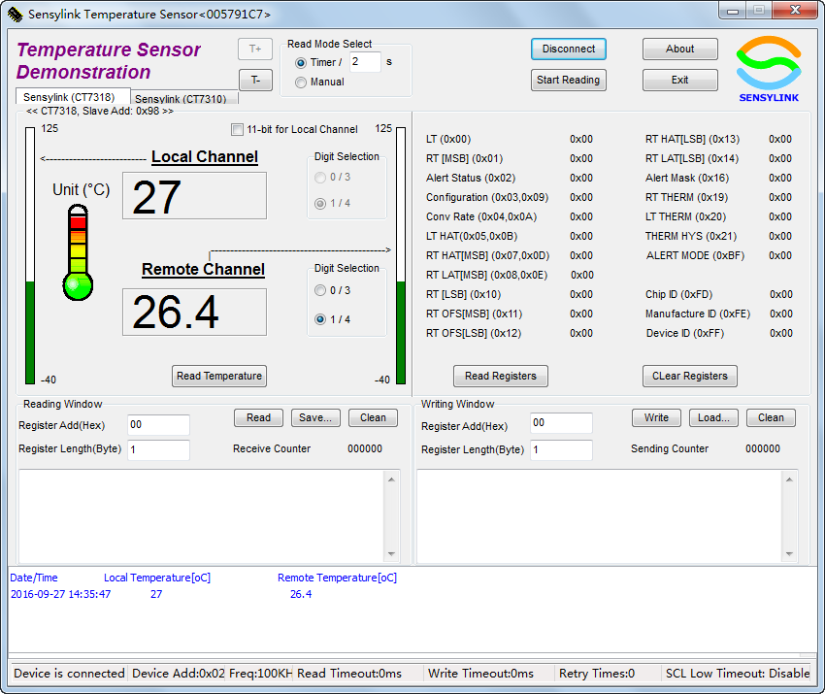
T-Sensor -- Demo App [CT7318]

Slide 36
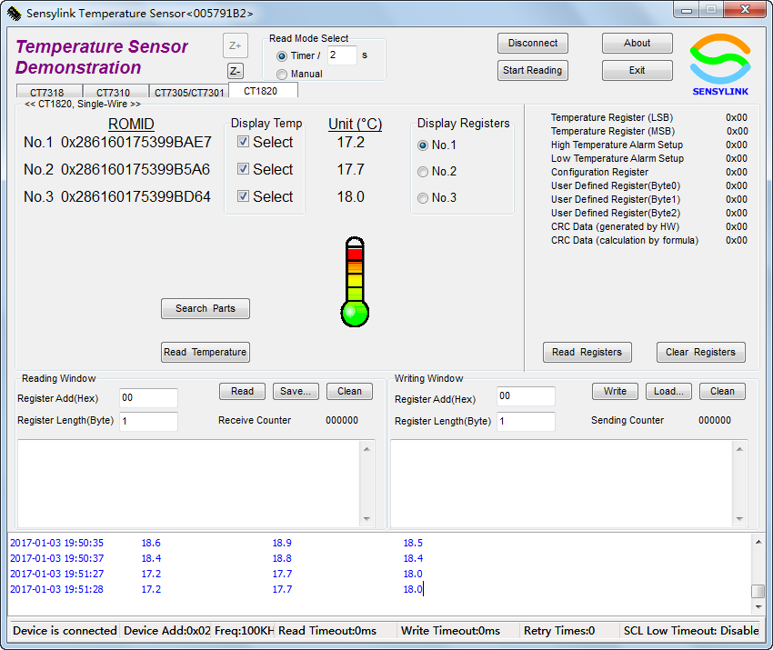
T-Sensor -- Demo App [CT1820]

Slide 37
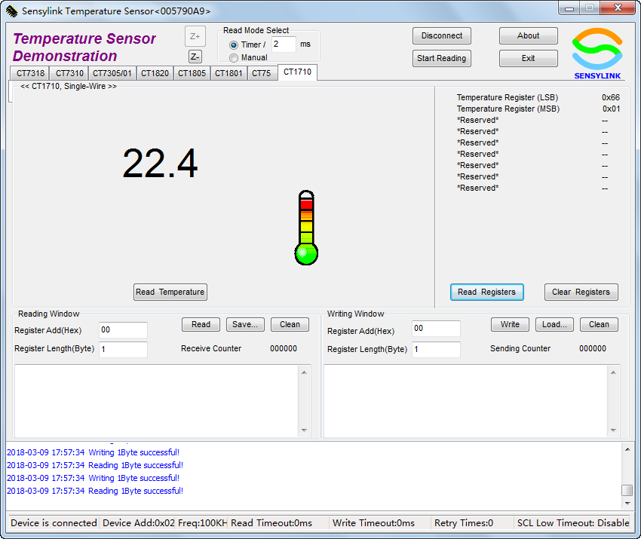
T-Sensor -- Demo App [CT1710]

Slide 38
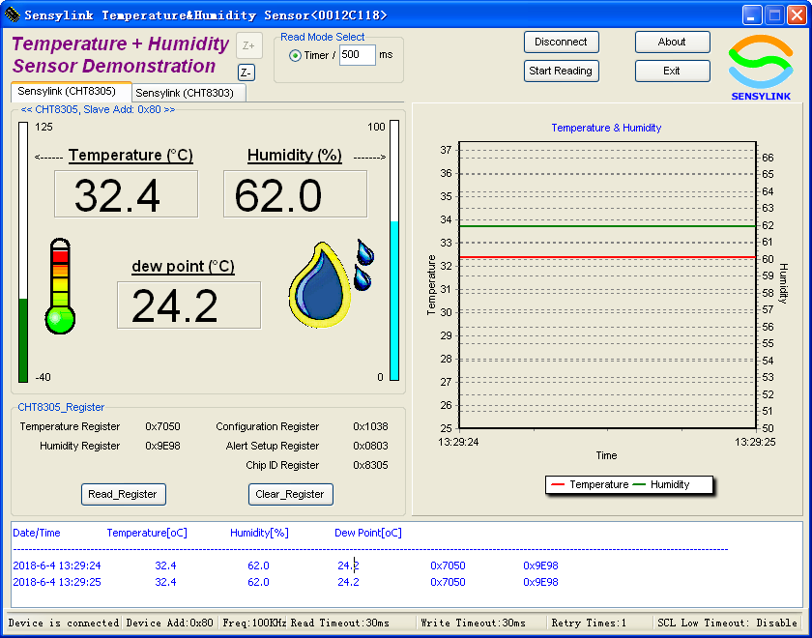
TH-Sensor -- Demo App [CHT8305]

Slide 39
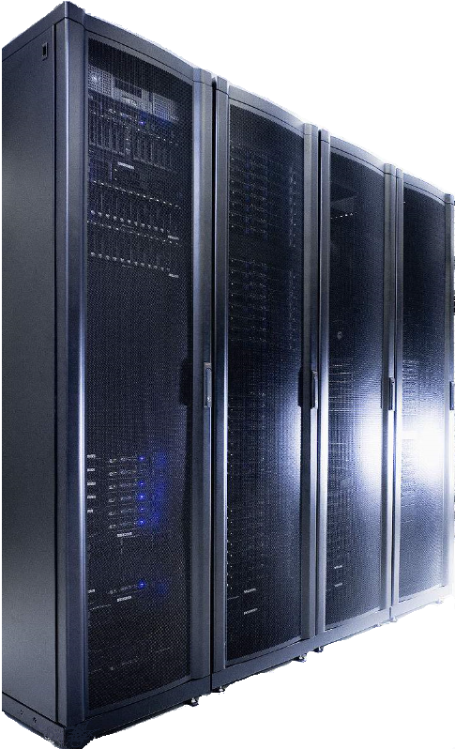
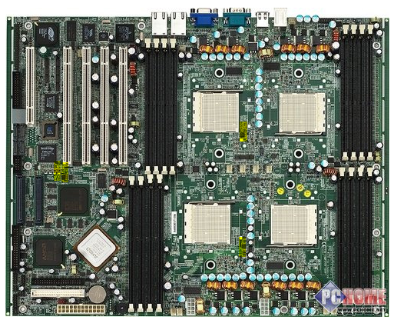
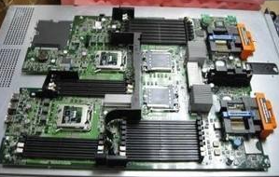

Application---Server, Notebook, Desktop
CT7432
CT7305/01
CT7318
CT7315
CT75
6人
13人
3人
3人
2人

Slide 40
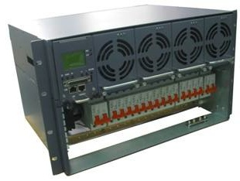
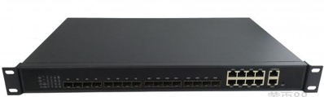
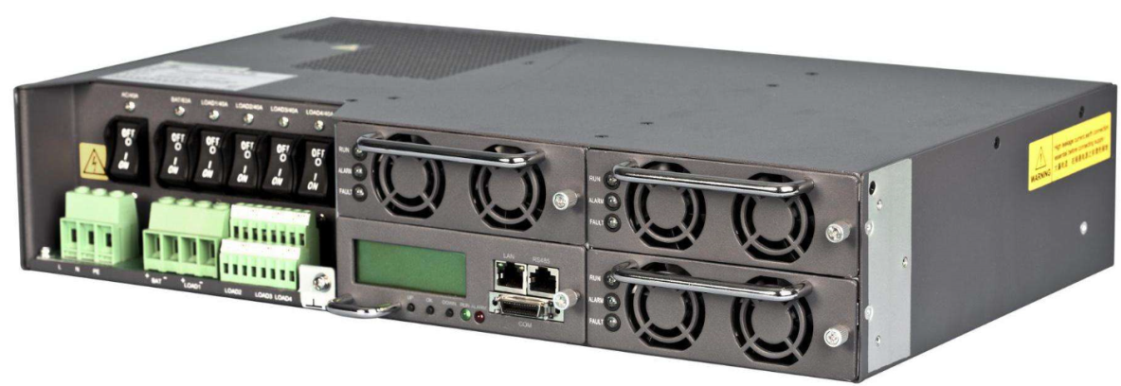
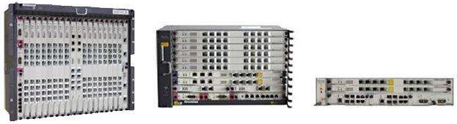
Application---DataCom
CT7432
CT7305/01
CT7318
CT75
CT1705
6人
13人
3人
3人
2人

Slide 41
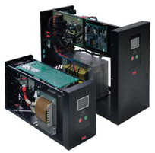
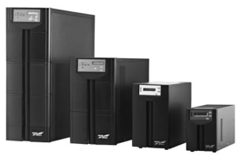
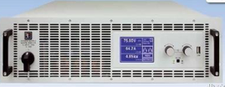
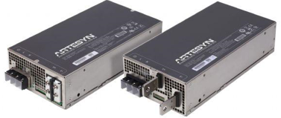
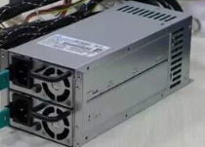
Application---Digital Power, UPS
CT7342
CT7305/01
CT7318
CT7315
CT75
CT1710/05
6人
13人
3人
3人
2人

Slide 42
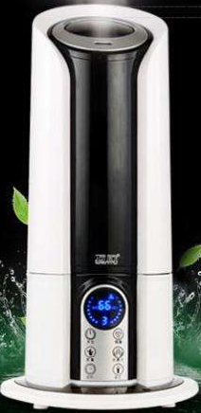
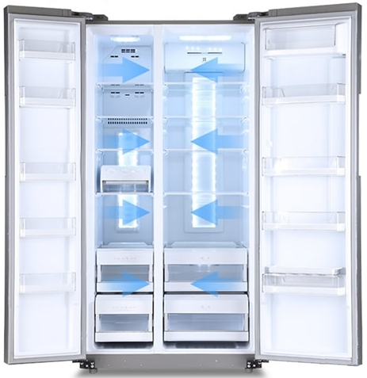
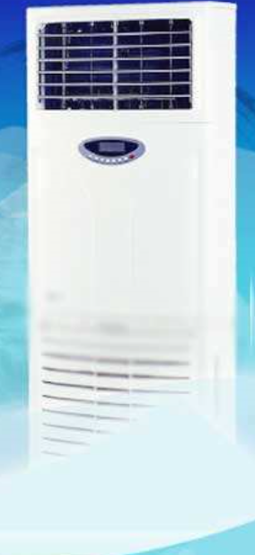
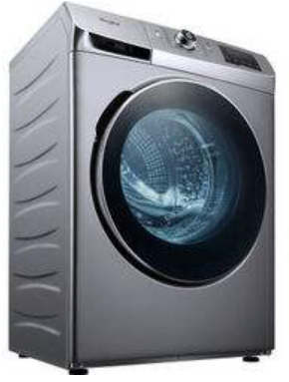
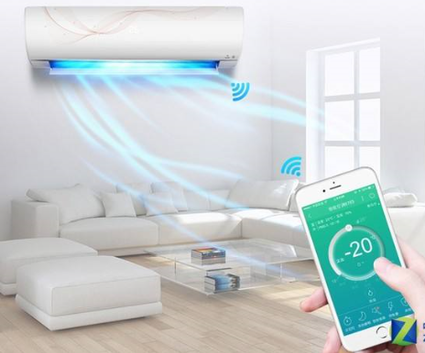
Application---Smart Refrigerator
Smart Refrigerator
CT1710/05
CHT8305
CHT8303

Slide 43
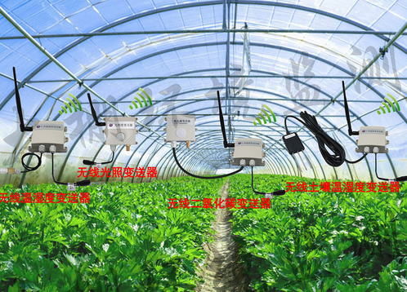
Application -- Smart Farm
CT1820
CHT8305
CHT8303

Slide 44
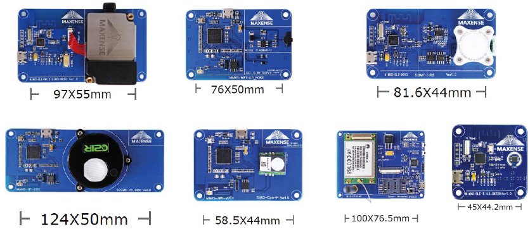
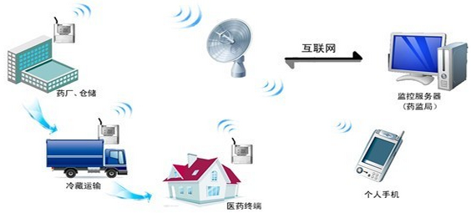
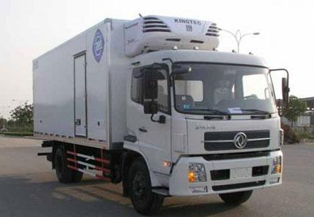
Application – Cold-Chain
CT1705
CHT8305
CHT8303

Slide 45
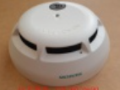

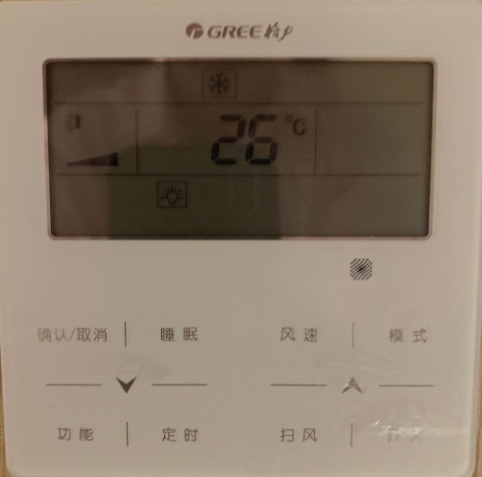
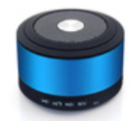
Application – IoT
智能烟感、温湿度计、蓝牙音箱
CT1705
CHT8305
CHT8303

Slide 46
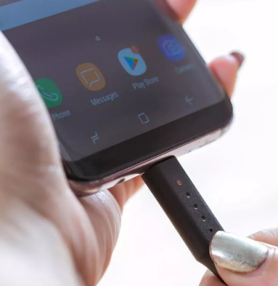

Application – USB Type C Cable(Smart)
Opportunity
CHT8305
CT712x
1，内置温度和湿度传感器的智能充电线：wibo(USA)
特别之处是wibo内置温度和湿度传感器，当距离热源太近或充电接口有水时，也会自动停止充电，同时以红色灯光提醒用户。含24W QC3快充头的价格是36美元，约合248元人民币，2018年10月发货。
2，Smart Type C Cable
需求條件如下:
1. IC package : CSP-4
2. VCC : 2.5V~5.5V
3. 溫度截點 : 75℃
4. Active Low ( 高溫拉Low )

Slide 47
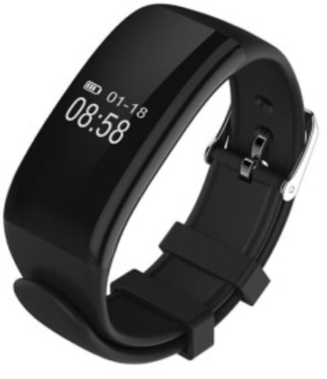
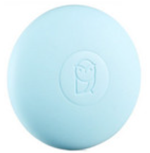
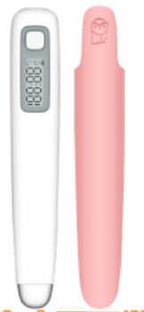
Application – (Human body Temperature Monitor )
Opportunity
CT1711MCR

Slide 48

Application – (handheld two way radio)
Opportunity
CT7112ADNR
CT18xxx
1，中高功率无线射频需要温度监测（商务、警务、军务用）
2，电池加密

Slide 49
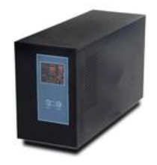
Application – (UPS)
Opportunity
CT1712Z2
CT75MR
CHT8305DNR

Slide 50
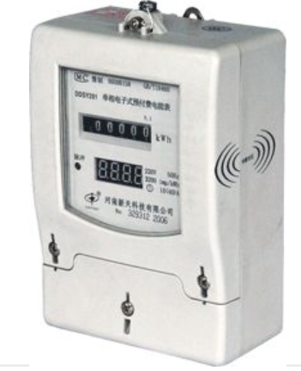

Application – (Power Meter)
Opportunity：
接线端子测温：CT1712Z2
CHT8305DNR

Slide 51



Application – (Gas&Water Meter)
Opportunity
CT75DNR
CT7112ADNR
CT1801Z

Slide 52


Partner

